Slide 1
Welcome to Chemistry 105!
Some preliminary notes …
Recognize that Puget Sound campus is built on land that has been occupied by the Puyallup people for thousands of years
We are living in uncertain and difficult times
Ground rules of interaction between us include a commitment to a respectful, safe space, that we agree to challenge the idea, not the person – and that we can revisit these rules as we go along

Slide 2
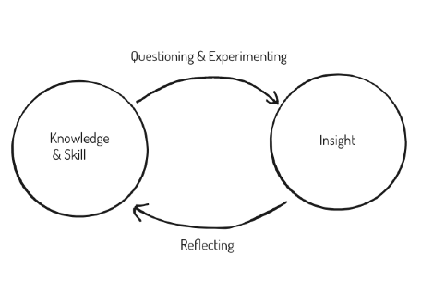
What is this course about?
Learning to think about climate & climate change as chemists
How? You’ll be driving a lot of this

Slide 3
Evaluation
See Canvas

Slide 4
Questions so far?

Slide 5
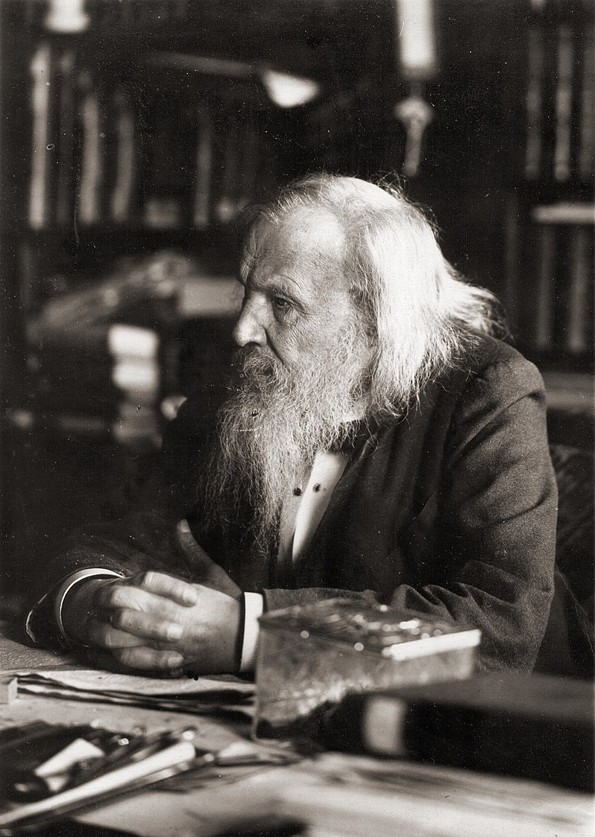
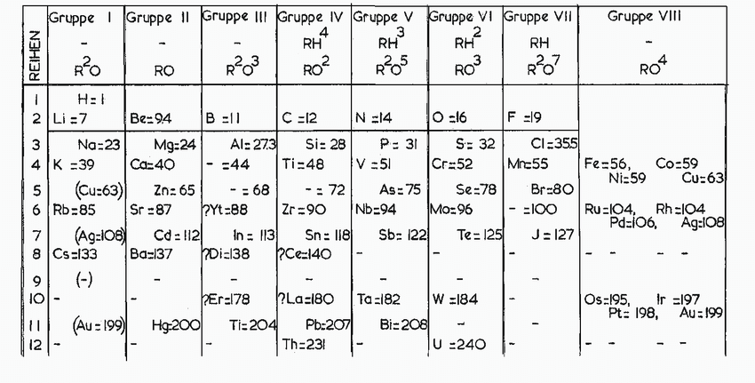
Periodic table basics
Dmitri Ivanovich Mendeleev
(youngest of 17 siblings!), Table published in 1871
https://www.researchgate.net/profile/Eric-Scerri/publication/323028562/figure/fig1/AS:592041121681409@1518165011651/The-Mendeleev-Periodic-Table-of-1871.png

Slide 6
Periodic table basics
Each box displays the symbol of an element (H, He, etc.)
Top of each box also has that element’s atomic number (H is #1, He is #2, etc)
Columns of elements are called families (or groups) that have similar chemical properties (the Noble Gas family is the right-most column)
Notice the big metal/nonmetal divide
Most elements shown have been found on Earth and are stable -- they last indefinitely. There are also man-made elements, most of which are unstable -- they last only a fraction of a second

Slide 7
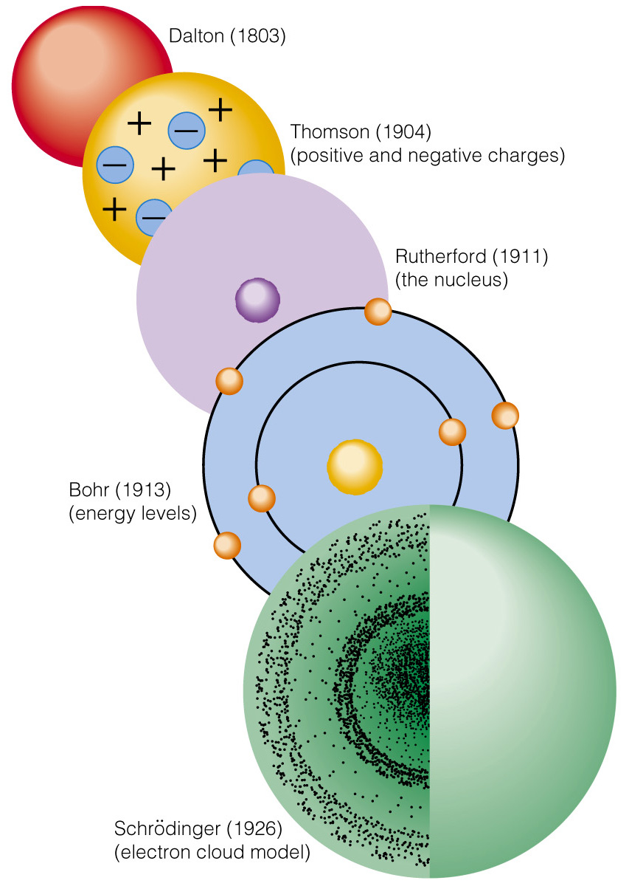
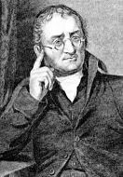
The evolving way people have thought about atomic structure
John Dalton
All matter is made up of tiny atoms.
Charlotte Brontë’s Jane Eyre (published 1847):
“Every atom of your flesh is as dear to me as my own”
“You will be dashed to atoms”

Slide 8
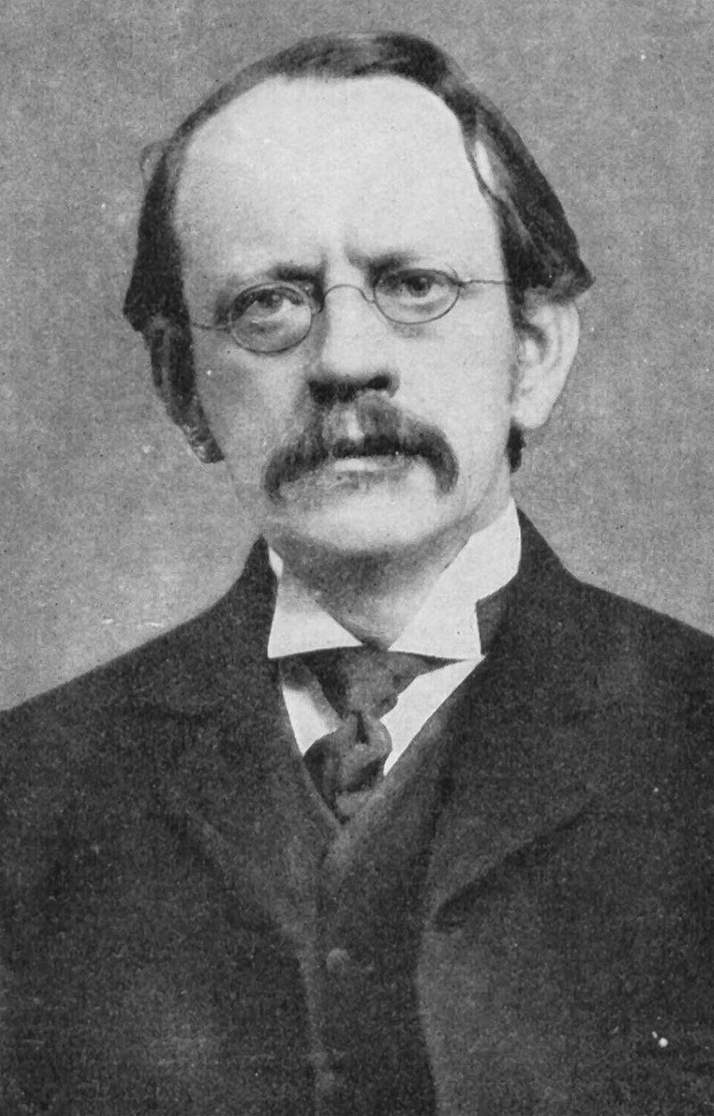
The evolving way people have thought about atomic structure
J.J. Thomson
Atoms are actually a mix-up of positive and negative parts.
The positive and negative parts are attracted to one another in the same way socks sometimes stick to one another (e.g., in a clothes dryer).

Slide 9
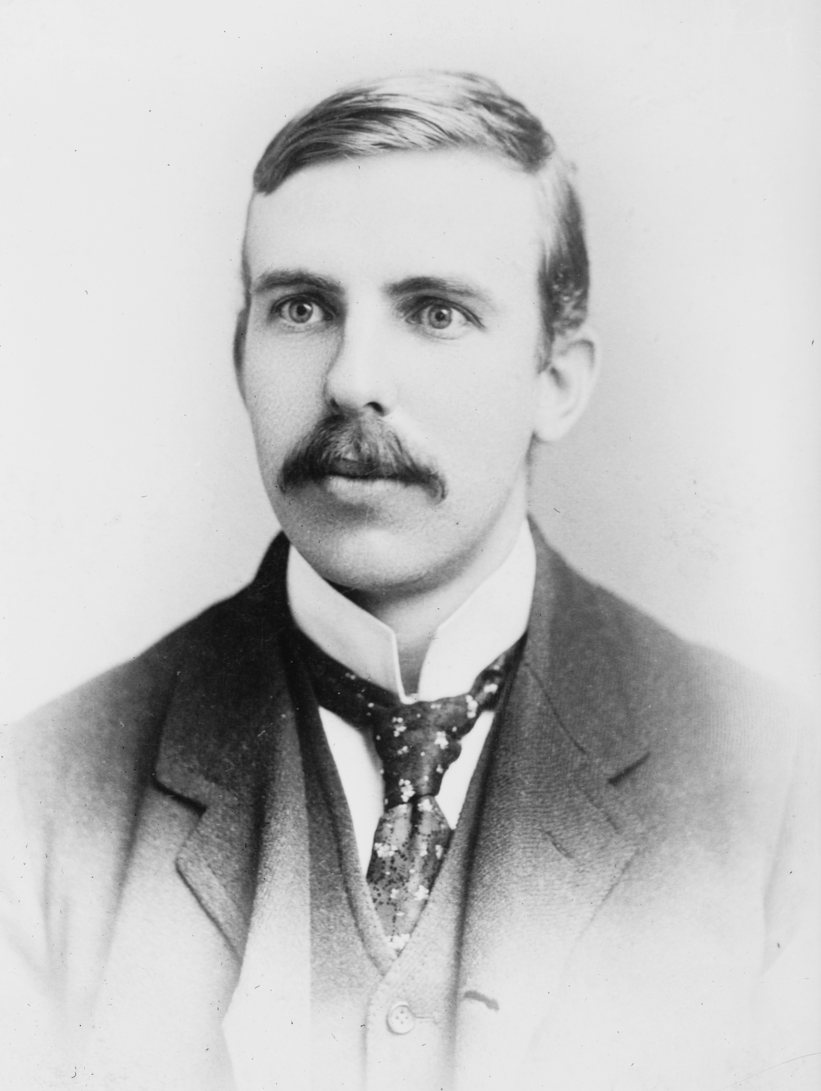
The evolving way people have thought about atomic structure
Ernest Rutherford
There’s a tiny nucleus at the center of every atom, that accounts almost all of the atom’s mass and all of its positive charge

Slide 10
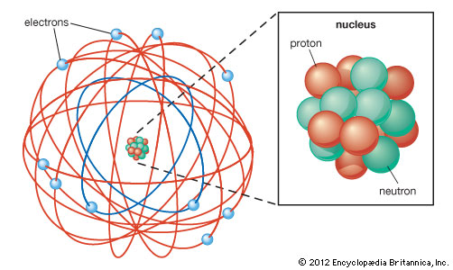
The evolving way people have thought about atomic structure
Ernest Rutherford
There’s a tiny nucleus at the center of every atom, that accounts almost all of the atom’s mass and all of its positive charge
Now we know that the nucleus is made of protons and neutrons. Each proton has a charge of +1, and the total # of protons is the atomic number on the periodic table!
=

Slide 11
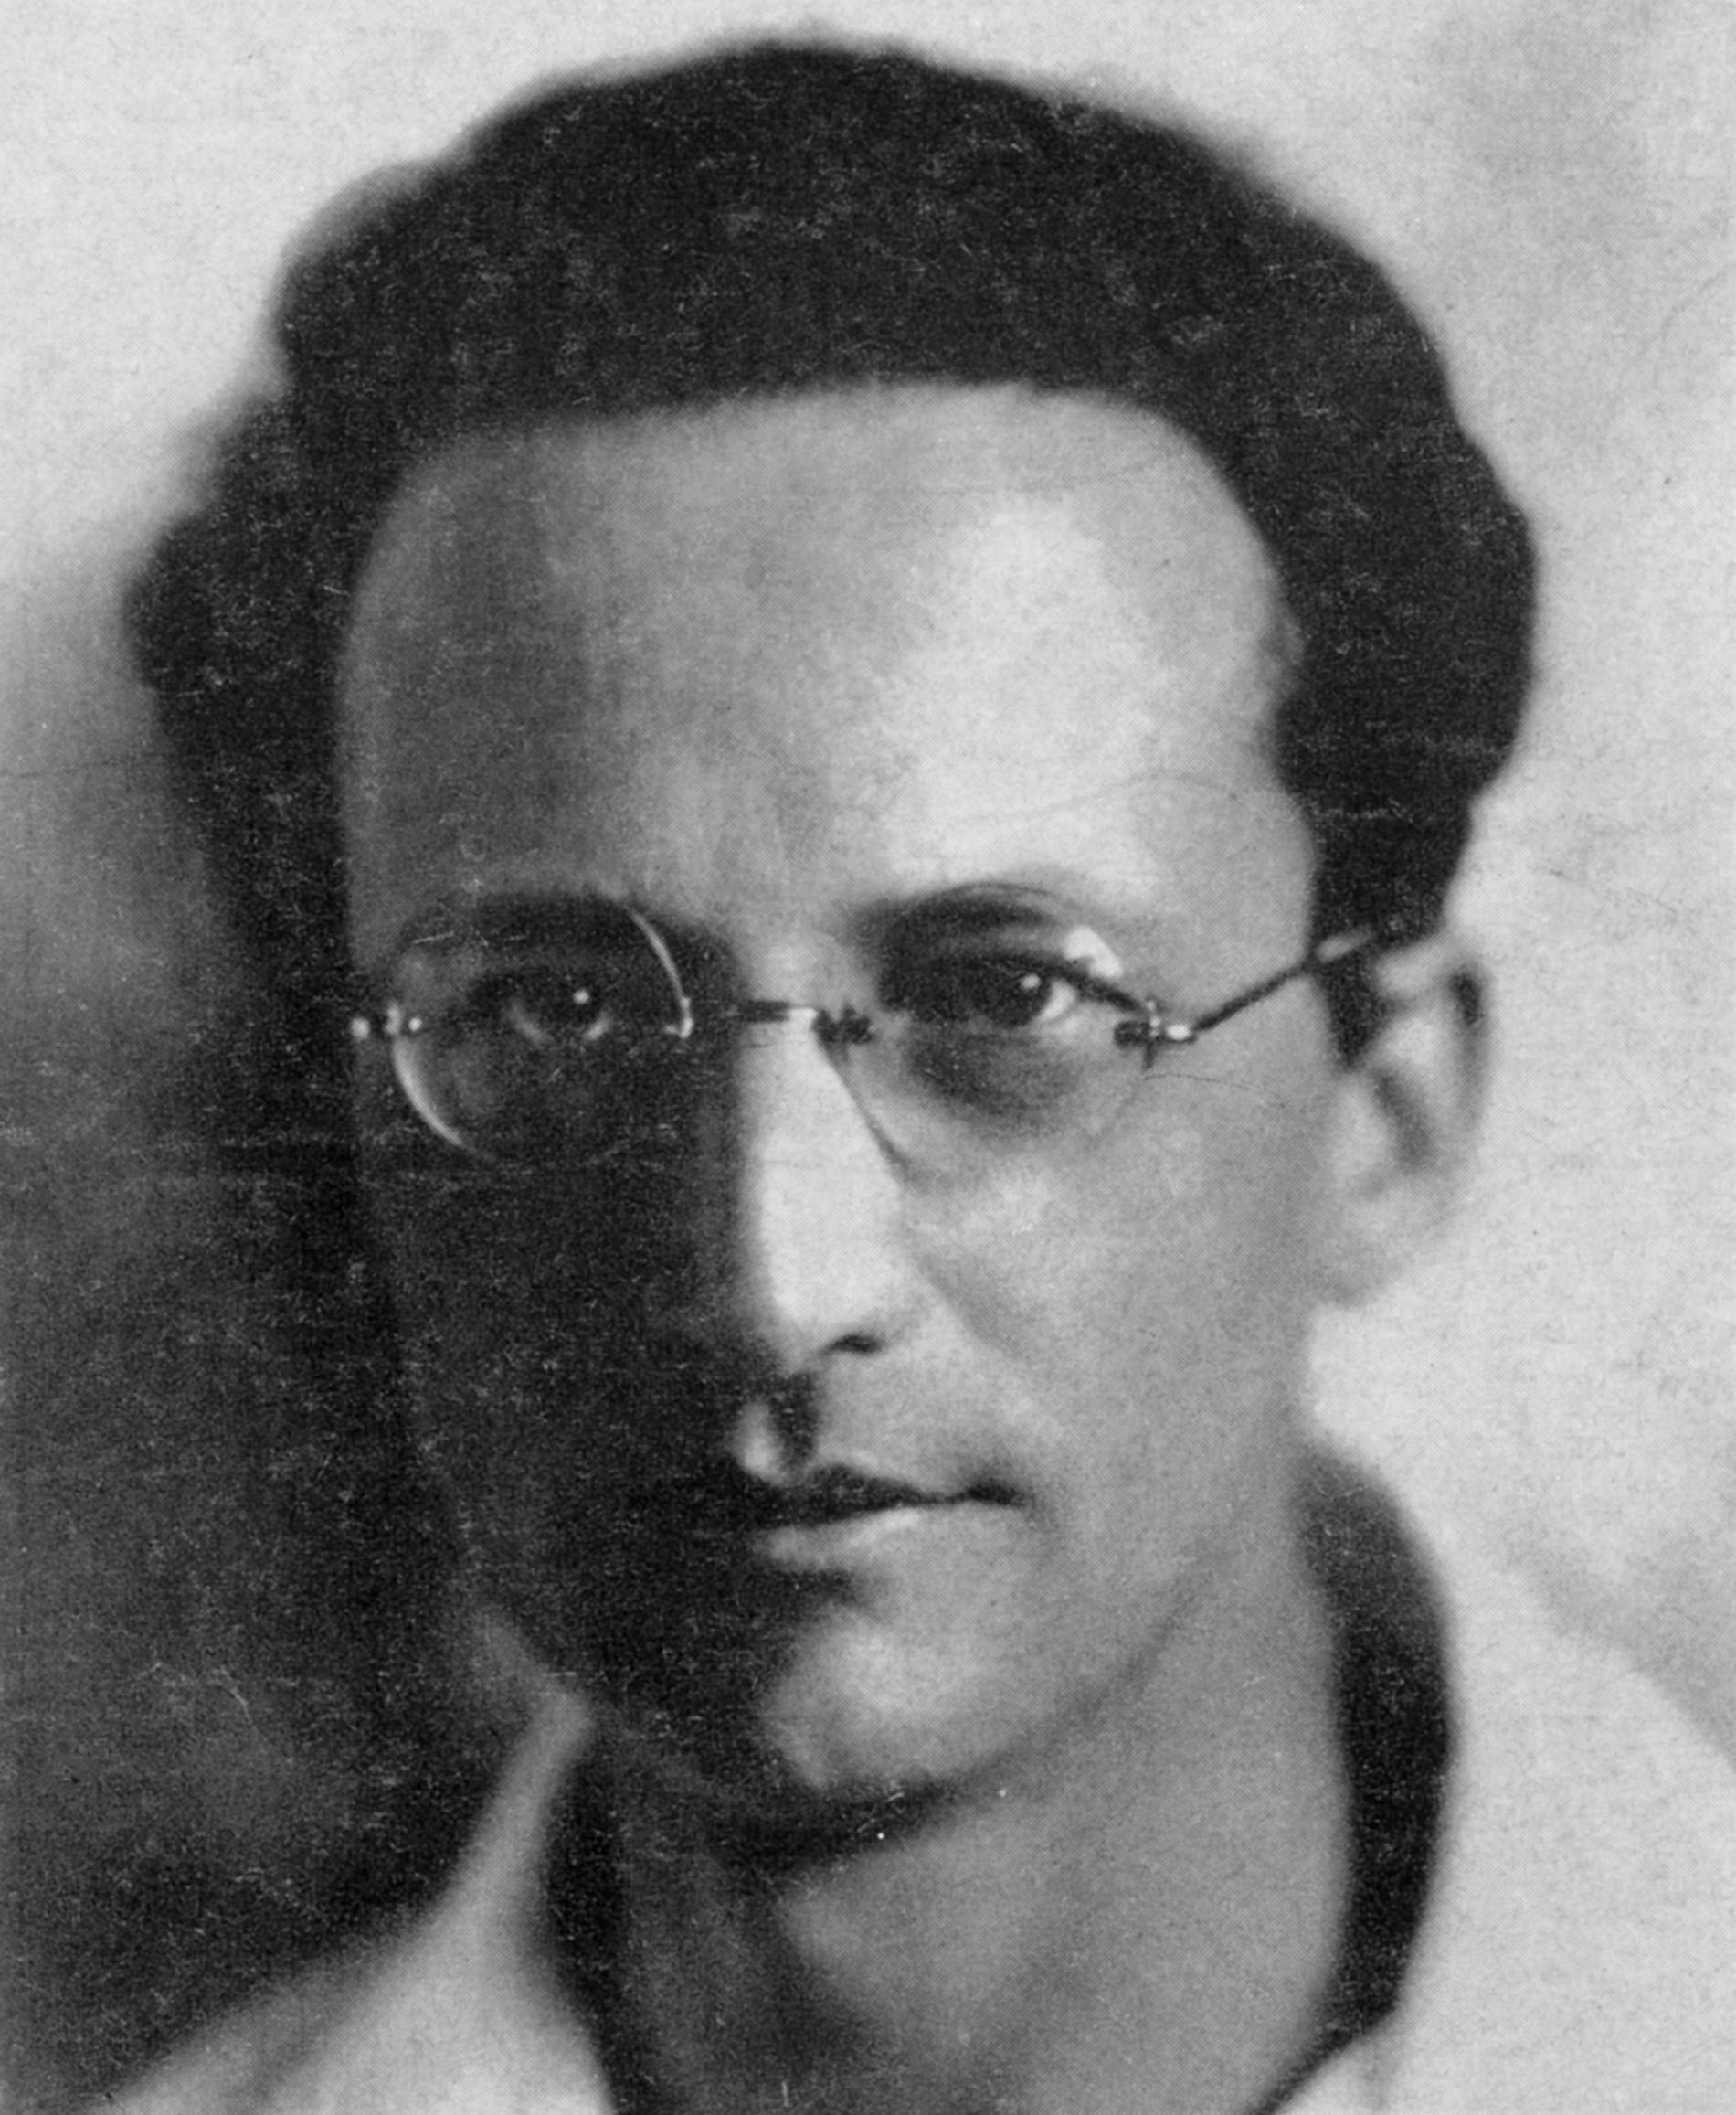
The evolving way people have thought about atomic structure
Erwin Schrödinger
The negative parts of an atom surround the nucleus in a cloud of fast-moving, negatively-charged particles called electrons.
This cloud is responsible for the size of the atom.
Generally, the number of electrons equals the number of protons in the nucleus, so the atom has no net charge: it’s neutral-charged.
You can see that the electron cloud is actually layered to make shells (also called levels)

Slide 12
The evolving way people have thought about atomic structure
Erwin Schrödinger
The negative parts of an atom surround the nucleus in a cloud of fast-moving, negatively-charged particles called electrons.
This cloud is responsible for the size of the atom.
Generally, the number of electrons equals the number of protons in the nucleus, so the atom has no net charge: it’s neutral-charged.
You can see that the electron cloud is actually layered to make shells (also called levels)
Looks like there are three shells here

Slide 13
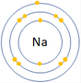
The evolving way people have thought about atomic structure
Erwin Schrödinger
The negative parts of an atom surround the nucleus in a cloud of fast-moving, negatively-charged particles called electrons.
This cloud is responsible for the size of the atom.
Generally, the number of electrons equals the number of protons in the nucleus, so the atom has no net charge: it’s neutral-charged.
You can see that the electron cloud is actually layered to make shells (also called levels)
Here’s a very abstract depiction of an atom with electrons in three shells (but we’ll use it anyway)
Looks like there are three shells here

Slide 14
An example
Ernest Rutherford
There’s a tiny nucleus at the center of every atom, that accounts almost all of the atom’s mass and all of its positive charge
What’s this element?
=

Slide 15
An example
Ernest Rutherford
There’s a tiny nucleus at the center of every atom, that accounts almost all of the atom’s mass and all of its positive charge
What’s this element?
Looks like 7 protons …
=

Slide 16
An example

Slide 17
An example

Slide 18
Before next time (see Canvas)
Build some atoms using the PhET atom simulator

